Slide 1
UNDERSTANDING THE EVOLUTION OF BACTERIA WITH MACHINE LEARNING
Computer Science Department
Naman Kanwar and Harnoor Singh
Advisor: Daniel Pimentel

Slide 2
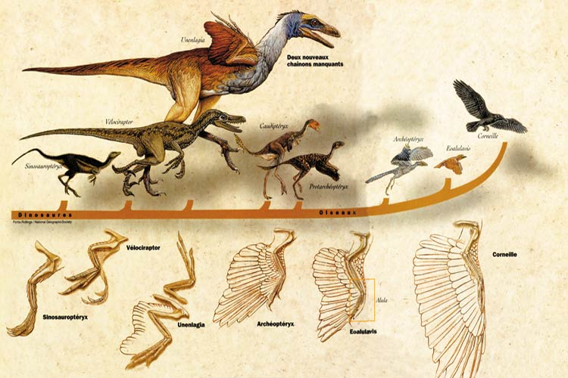
Evolution

Slide 3
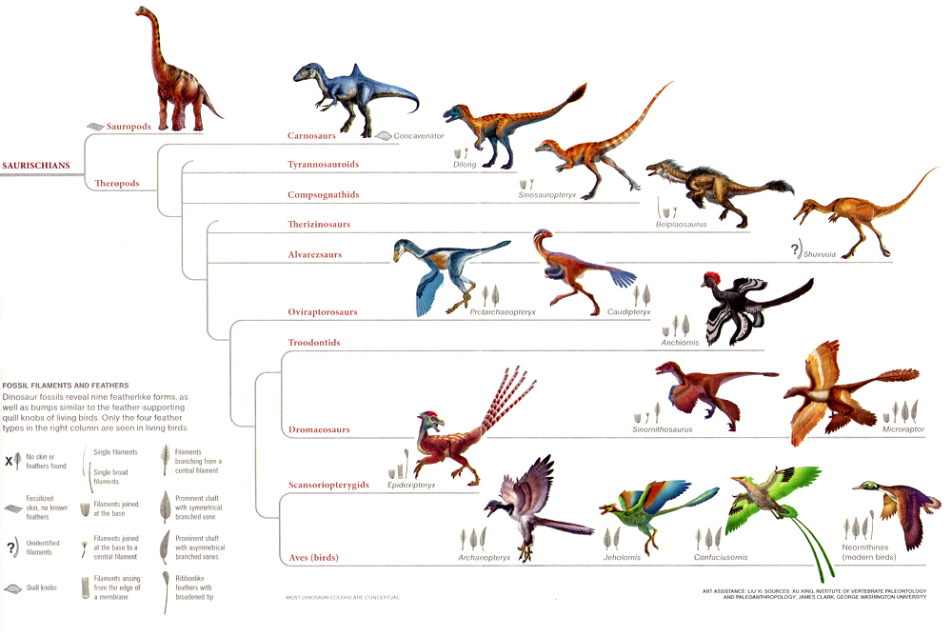
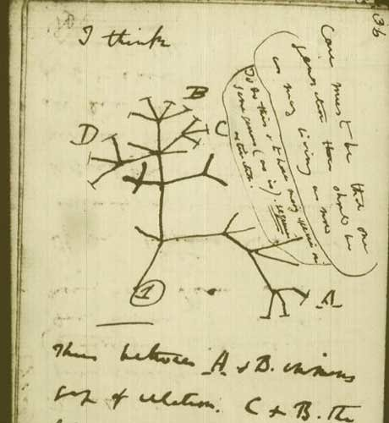

Slide 4
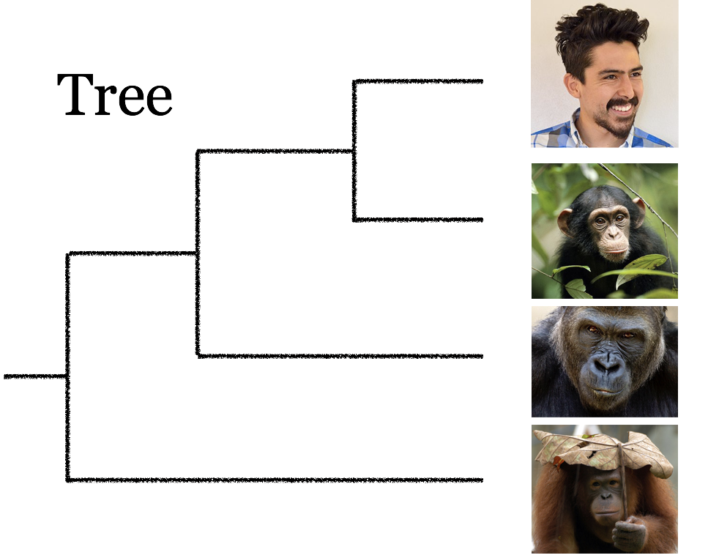
Phylogenetic Tree
Notes:
Why do we care?
Phylogenetics studies evolution, which is depicted as a bifurcating tree. This tree represents the evolutionary history of 4 primates: human, chimpanzee, gorilla and orangutan. Humans and chimpanzees are sister species because they share a common ancestor (represented by the internal node in the tree).

Slide 5


Others
Dentist
AIDS
Motivation
Biology, Linguistics, Forensics
Notes:
Motivation
Biology, Linguistics, Forensics
What is the connection between studying bacteria and phylogenetic trees?

Slide 6
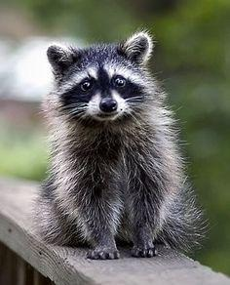
Why is It Difficult?
1 Species = 1 Tree

Slide 7
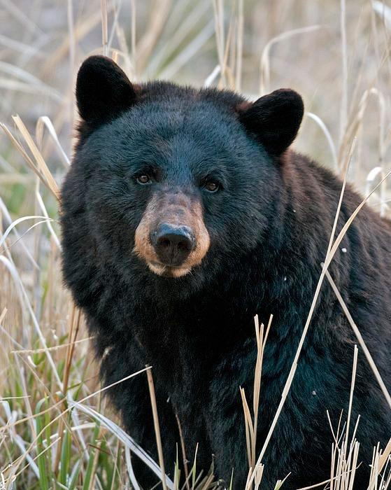
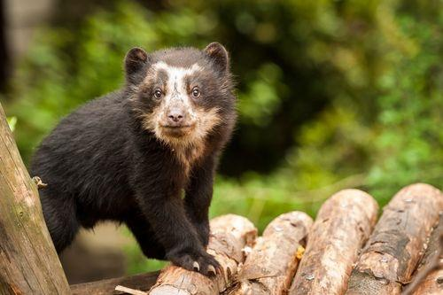
Why is It Difficult?
2 Species = 1 Tree

Slide 8
Why is It Difficult?
3 Species = 3 Trees

Slide 9
Why is It Difficult?
3 Species = 3 Trees

Slide 10
Why is It Difficult?
3 Species = 3 Trees

Slide 11
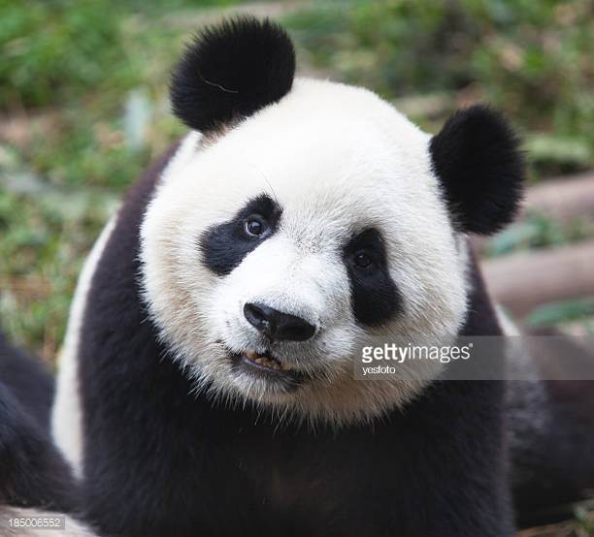
Why is It Difficult?
4 Species = 15 Trees

Slide 12
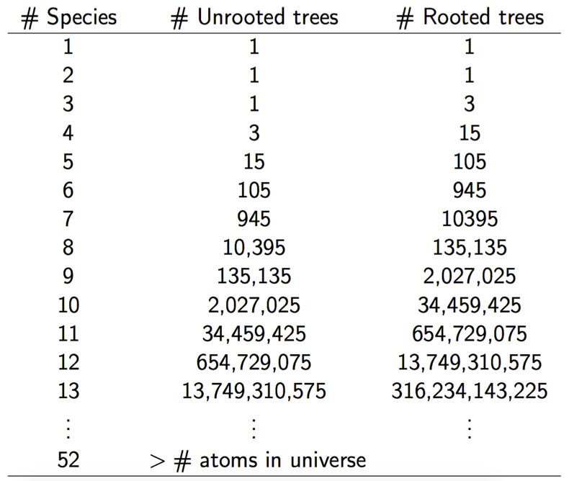
Why is It Difficult?
52 Species = More than Atoms of Universe

Slide 13
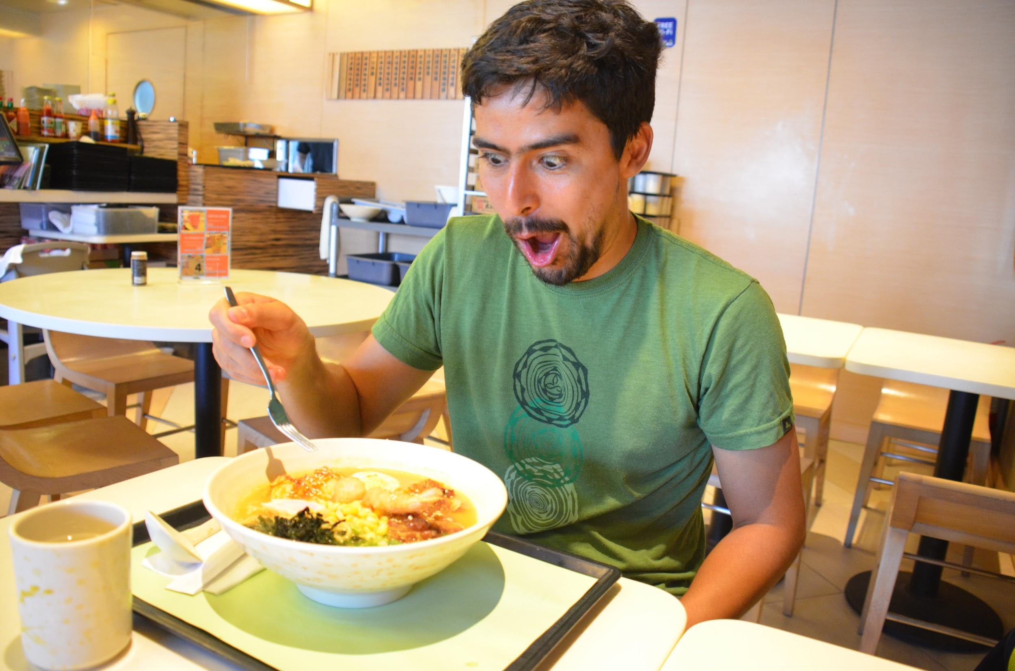
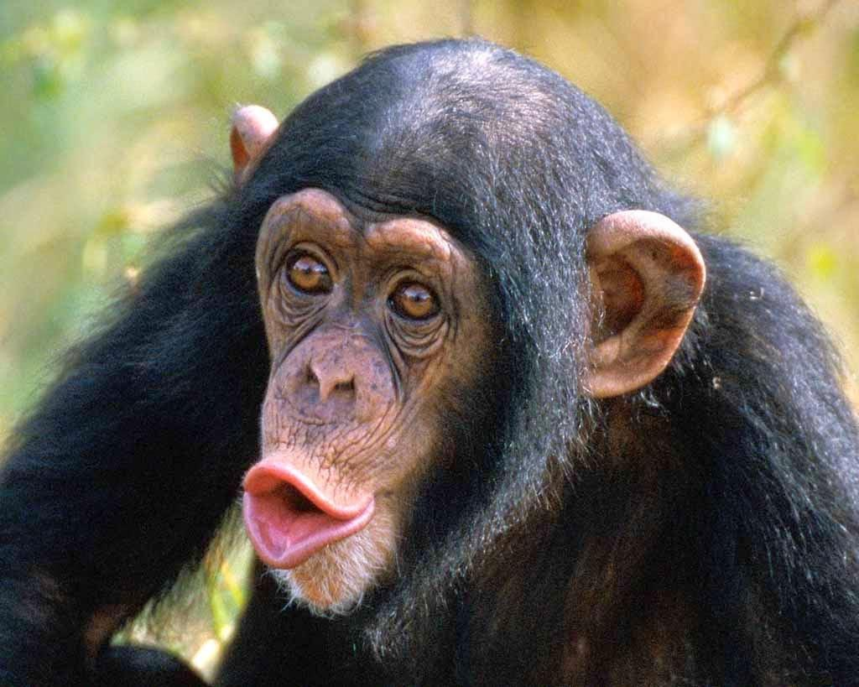
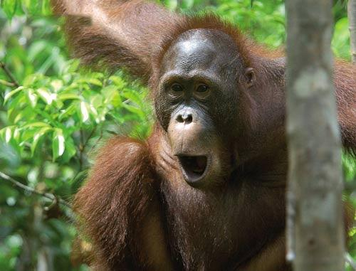
Phylogenetic Tree

Slide 14


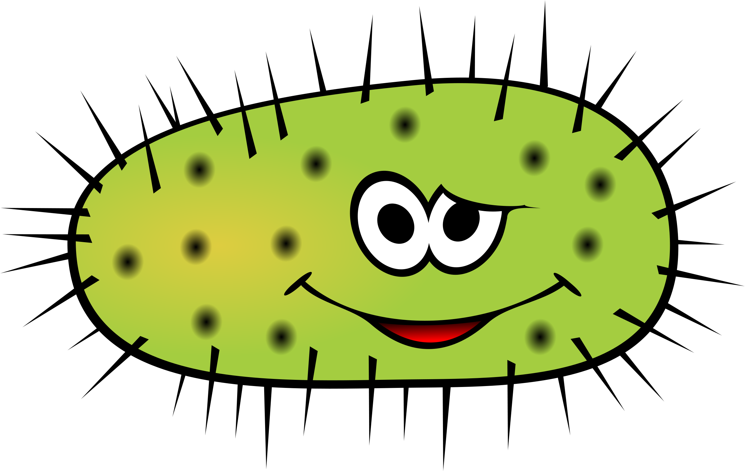
Phylogenetic Tree

Slide 15
Phylogenetic Network

Slide 16
Phylogenetic Network

Slide 17
Phylogenetic Network

Slide 18
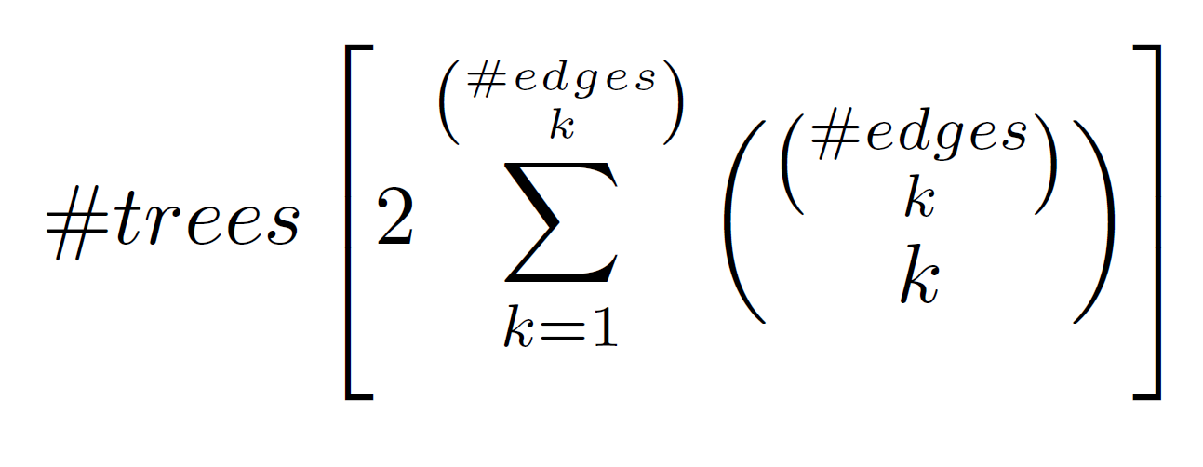
#Networks =
Phylogenetic Network

Slide 19

6
5
4
3
2
1
Time
1 2 3
Number of Species
Exponential Computation Time

Slide 20
15
14
13
12
11
10
9
8
7
6
5
4
3
2
1
Time
1 2 3 4
Number of Species
Exponential Computation Time

Slide 21
days
.
.
24
22
20
18
16
14
12
10
8
6
4
2
Time
1 2 3 4 5
Number of Species
Exponential Computation Time

Slide 22
weeks
.
.
. 1week
.
.
.
.
.
days
20
15
10
5
Time
1 2 3 4 5 6
Number of Species
Exponential Computation Time

Slide 23
1month
.
weeks
.
.
. 1week
.
.
.
days
20
15
10
5
This is the
importance
of our work!
Time
1 2 3 4 5 6 7 8 9 10
Number of Species
Exponential Computation Time

Slide 24

Department of Human Genetics
Emory University
PhD Statistics
Claudia Solis- Lemus

Slide 25
Method of Inquiry
[1] M. Ajtai, J. Komlós, E. Szemerédi, An O(n log n) sorting network, in: Proc. 15th Annu. ACM Symp. on the Theory of Computing (STOC’83), 1983, pp. 1–9.
[2] D. Bryant. Building trees, hunting for trees, and comparing trees: theory and methods in phylogenetic analysis, Ph.D. Thesis, University of Canterbury, Christchurch, New Zealand, 1997.
[3] A.V. Aho, Y. Sagiv, T.G. Szymanski, J.D. Ullman, Inferring a tree from lowest common ancestors with an application to the optimization of relational expressions, SIAM J. Comput. 10 (3) (1981) 405–421.
[4] D. Bryant, V. Moulton, Neighbor-net: an agglomerative method for the construction of phylogenetic networks, Mol. Biol. Evol. 21 (2) (2004) 255–265.
[5] B. Chor, M. Hendy, D. Penny, Analytic solutions for three-taxon MLMC trees with variable rates across sites, in: Proc. of the First Workshop on Algorithms in Bioinformatics (WABI 2001), Lecture Notes in Computer Science, Vol. 2149, Springer, Berlin, 2001, pp. 204–213.
[6] C. Choy, J. Jansson, K. Sadakane, W.-K. Sung, Computing the maximum agreement of phylogenetic networks, Theoret. Comput. Sci. 335 (1) (2005) 93–107.
[7] T. Cormen, C. Leiserson, R. Rivest, Introduction to Algorithms, The MIT Press, MA, 1990.
[8] L. G¸asieniec, J. Jansson, A. Lingas, A. Östlin, Inferring ordered trees from local constraints, in: Proc. of Computing: the Fourth Australasian Theory Symposium (CATS’98), Australian Computer Science Communications, Vol. 20(3), Springer, Singapore, 1998, pp. 67–76.
[9] Jansson, J. and Sung, W. (2018). Inferring a level-1 phylogenetic network from a dense set of rooted triplets. [online] Www-new.comp.nus.edu.sg. Available at: https://wwwnew.comp.nus.edu.sg/~wongls/psZ/apbc2005/camera-ready/173.pdf [Accessed 18 Jan. 2018].

Slide 26
Method of Inquiry
[1] M. Ajtai, J. Komlós, E. Szemerédi, An O(n log n) sorting network, in: Proc. 15th Annu. ACM Symp. on the Theory of Computing (STOC’83), 1983, pp. 1–9.
[2] D. Bryant. Building trees, hunting for trees, and comparing trees: theory and methods in phylogenetic analysis, Ph.D. Thesis, University of Canterbury, Christchurch, New Zealand, 1997.
[3] A.V. Aho, Y. Sagiv, T.G. Szymanski, J.D. Ullman, Inferring a tree from lowest common ancestors with an application to the optimization of relational expressions, SIAM J. Comput. 10 (3) (1981) 405–421.
[4] D. Bryant, V. Moulton, Neighbor-net: an agglomerative method for the construction of phylogenetic networks, Mol. Biol. Evol. 21 (2) (2004) 255–265.
[5] B. Chor, M. Hendy, D. Penny, Analytic solutions for three-taxon MLMC trees with variable rates across sites, in: Proc. of the First Workshop on Algorithms in Bioinformatics (WABI 2001), Lecture Notes in Computer Science, Vol. 2149, Springer, Berlin, 2001, pp. 204–213.
[6] C. Choy, J. Jansson, K. Sadakane, W.-K. Sung, Computing the maximum agreement of phylogenetic networks, Theoret. Comput. Sci. 335 (1) (2005) 93–107.
[7] T. Cormen, C. Leiserson, R. Rivest, Introduction to Algorithms, The MIT Press, MA, 1990.
[8] L. G¸asieniec, J. Jansson, A. Lingas, A. Östlin, Inferring ordered trees from local constraints, in: Proc. of Computing: the Fourth Australasian Theory Symposium (CATS’98), Australian Computer Science Communications, Vol. 20(3), Springer, Singapore, 1998, pp. 67–76.
[9] Jansson, J. and Sung, W. (2018). Inferring a level-1 phylogenetic network from a dense set of rooted triplets. [online] Www-new.comp.nus.edu.sg. Available at: https://wwwnew.comp.nus.edu.sg/~wongls/psZ/apbc2005/camera-ready/173.pdf [Accessed 18 Jan. 2018].
Personally Contacted Authors!

Slide 27
Our Hypothesis:
A Divide and Conquer Strategy
Can speed things up

Slide 28
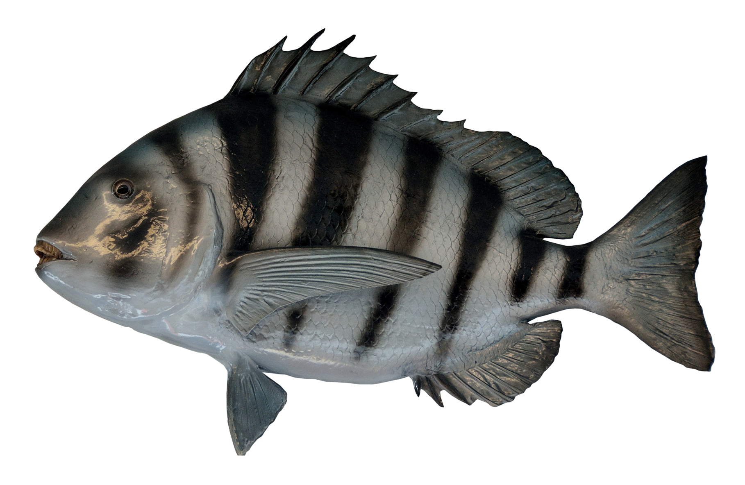
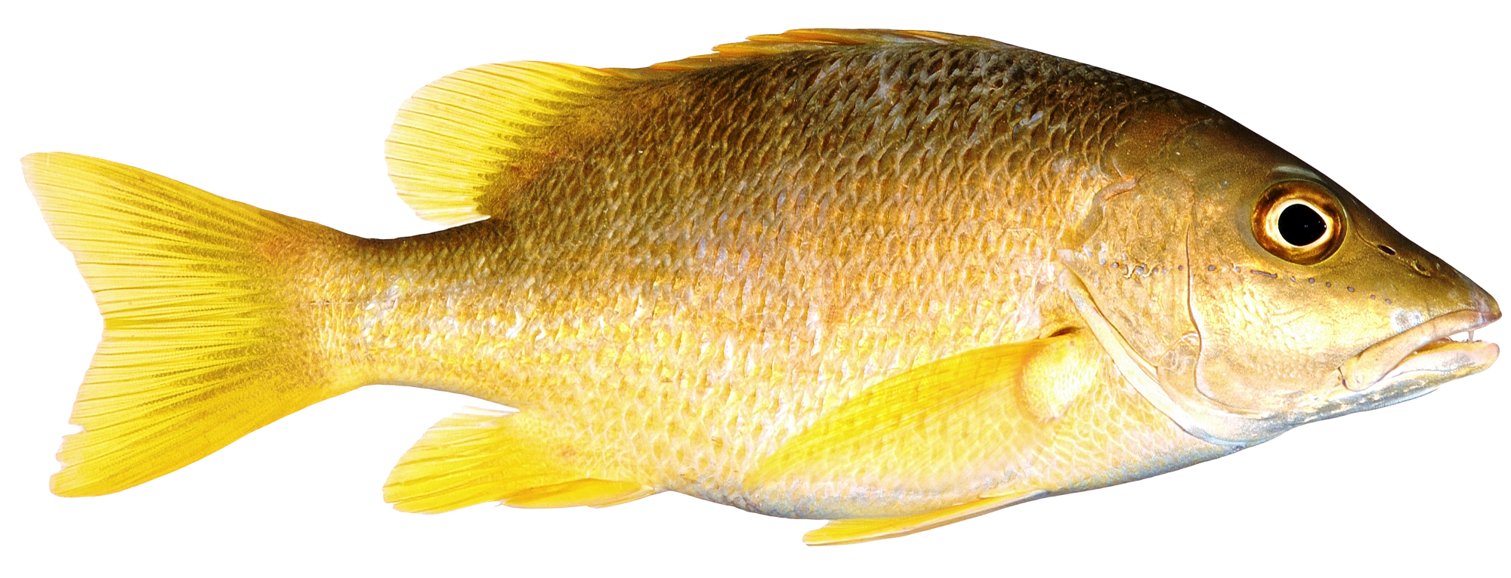
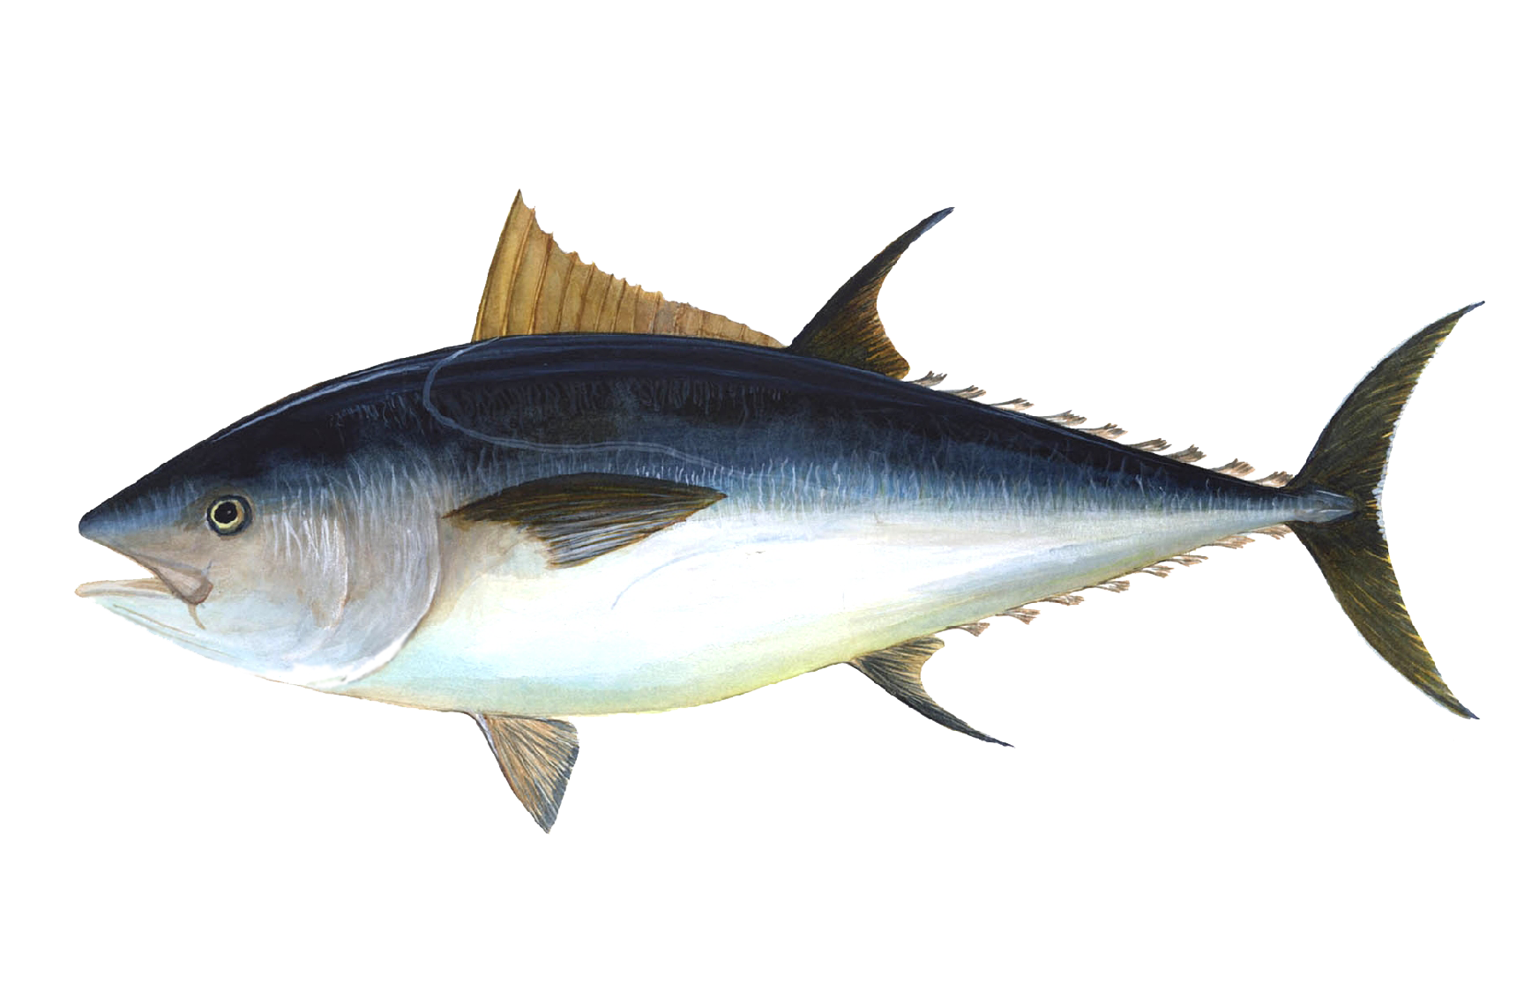


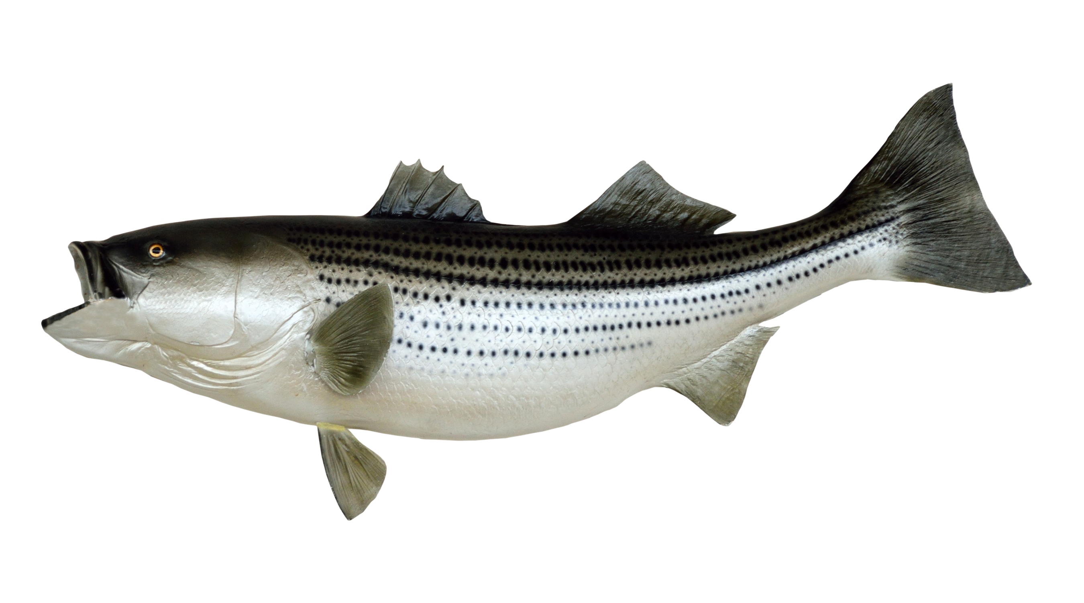
?
Our Strategy
6 Species = 945 Trees and even More Networks

Slide 29
Divide and Conquer
3 Species = 3 Trees

Slide 30
Divide and Conquer

Slide 31


{
}
Sub Network
=
+
Divide and Conquer

Slide 32
Sub Network { } = +
Sub Network { } = +
Sub Network { } = +
.
.
.
.
.
Sub Network { } = +
Stitch them Together
Notes:
Show one by one . Add title divide and conquer. Decrease the size

Slide 33
Network Inference

Slide 34

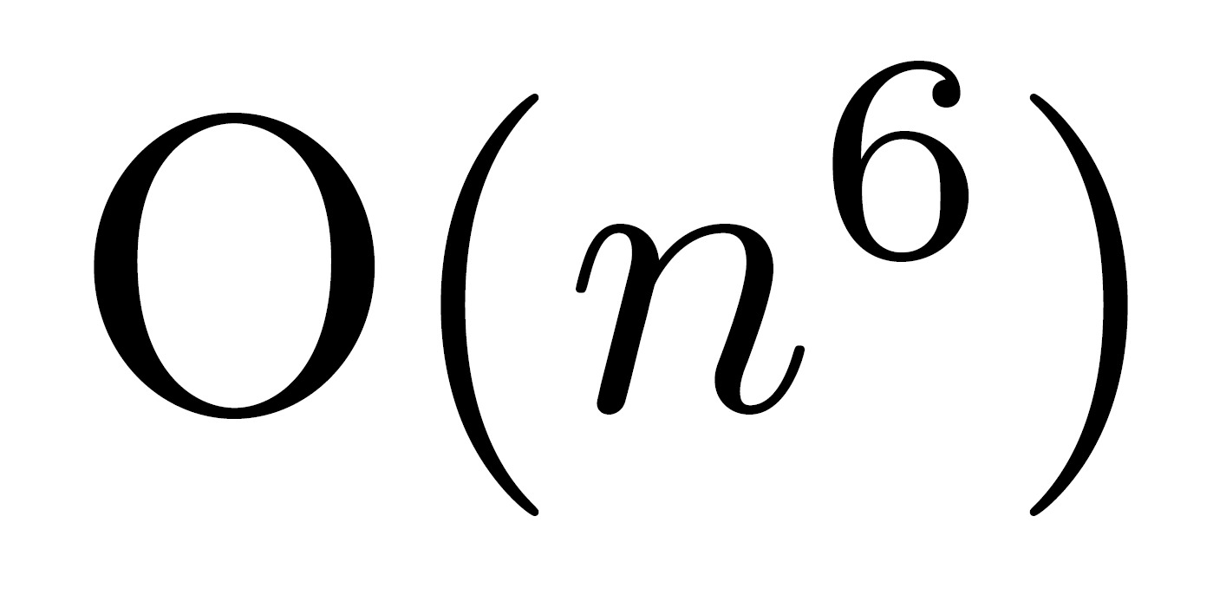
Results
Time
Number of Species
Exponential vs polynomial

Slide 35
Conclusion
Goal: Find Phylogenetic network
Motivation: Biology/ Linguistics/ Forensics
Develop Vaccines/ Drugs
Problem: Exponential Complexity
Inquiry: Asked experts and papers
Hypothesis: Divide and Conquer
Results: Polynomial is better than exponential
Questions?

